Slide 1
Alternative Approaches to Data Storing and Processing
Authors : Mihkel M. Maran , Nikolai A. Paniavin, Ilia A. Poliushkin
Presented By : Isha Vinod Jain
2021013\B4

Slide 2
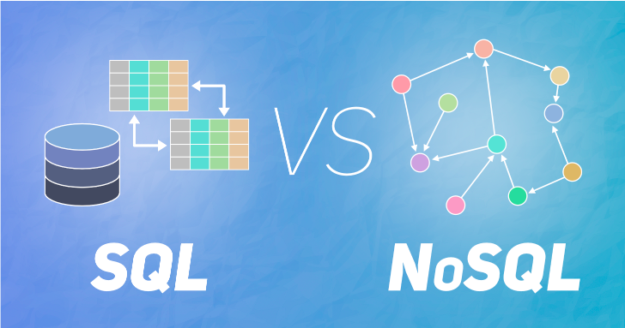
ABSTRact
Most data processing applications store data using a Database Management System (DBMS).
Since relational databases have poor performance on some types of data, there have appeared other approaches.
Fig No. 1

Slide 3
INTRODUCTION
Developing a software product in the initial stages, the programmer has the problem of selecting one or more DBMS from existing ones.
Today, various companies offer their solutions that can be conditionally divided into two directions, relational (SQL) and non-relational (NoSQL).
The differences between them are how they designed, what types of data support, how they store information.

Slide 4
Relational DBMS
Dr E.F. Codd proposed the idea of a new relational data model and specific language at IBM.
SQL cannot be fully assigned to programming languages because it contains only the data access operators stored in the database, and there are no operators that control program progress.
The second language QBE for relational databases was developed in parallel with SQL. Moshe M. Zloof proposed this variant.
QBE contained PRINT, INSERT, UPDATE, DELETE operations similar to SQL - SELECT, INSERT, UPDATE, DELETE.

Slide 5
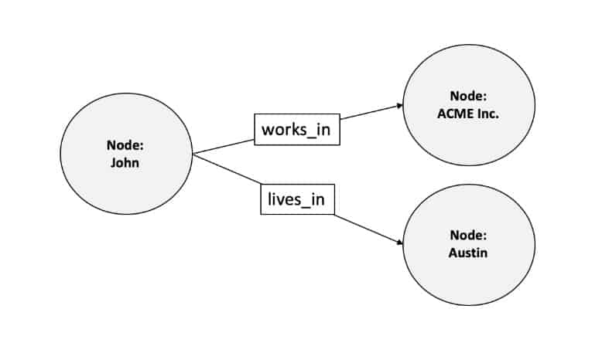
GRAPH DBMS
Graph Database presents data as entities, or nodes.
Fig No. 2

Slide 6
In the number of applications, the programmer has to work with data that is easier to represent as a graph than as tables.
Alternatively, it is possible to use non-relational NoSQL solutions with graph DBMS as one direction.
Currently, Neo4j is the most common graph DBMS.
If you compare with graph modelling on relational DBMS tools, this approach increases system efficiency by performing additional optimization.

Slide 7
DOCUMENT-ORIENTED DBMS
A document database is a type of non-relational database that is designed to store and query data as JSON-like documents.
The document model works well with use cases such as catalogs, user profiles, and content management systems where each document is unique and evolves over time.
The JSON format has three basic foundations:
Key value pairs or attributes
Embedding JSON objects
Arrays

Slide 8
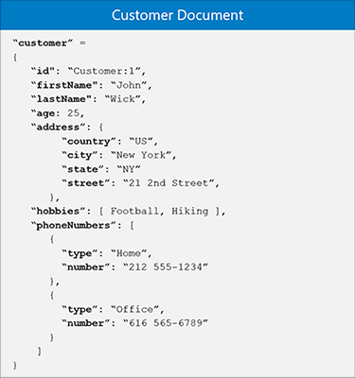
Fig No 3

Slide 9
Unlike relational systems, document databases allow you to query document sets using several attribute constraints, can perform aggregate queries, sort results, and support indexing of document fields.
Documentary systems usually do not support ACID semantics.
One representative of the document-oriented DBMS is MongoDB.

Slide 10
CONCLUSION
To solve the problem bases on social networks, transport maps, it is more convenient to use graphs that allow obtaining faster and more efficient solutions than relational DBMS.
When data is poorly structured and fits into a database without a fixed schema, Document-Oriented DBMS can take place.
The study assumes supplementing relational databases and not insists on their replacement.

Slide 11
THANKYOU!!

